Slide 1


Team name: INCREDIBLE BRAINHACKS
Team mentor: Mr. T. Mahesh Kumar
Team members:
Ruthvik Reddy Aileni
Rachana Vannala
Vyshnavi Malluru
Yuvaraj Puranam

Slide 2

Address update using supporting document
Problem statement 2
Suppose, a person own a new house or rent it ,to update Aadhaar address we need a rental agreement with the landlord or an address proof .

Slide 3
Introduction
Aadhaar card is used as an address proof and identity proof, it has to be updated whenever required
To update we have to approach revenue offices/Aadhaar centers, and it may take a lot of time to complete the process.
To overcome all these difficulties and for ease of updating the address in Aadhaar card we have developed an application.
This application requires supporting documents (i.e., Landlord's rental agreement/Any Municipality bills) for updation of address.

Slide 4
Proposed System
This Application is used by a mobile operator who goes door to door for address update.
Mobile operator asks for an Aadhaar number and address proof, if updation is required.
Address extracted from supporting document is converted into text and displayed for any minor edits.
The GPS location is accessed and compared with the displayed address.
If it is validated, then the address updation is successful.

Slide 5
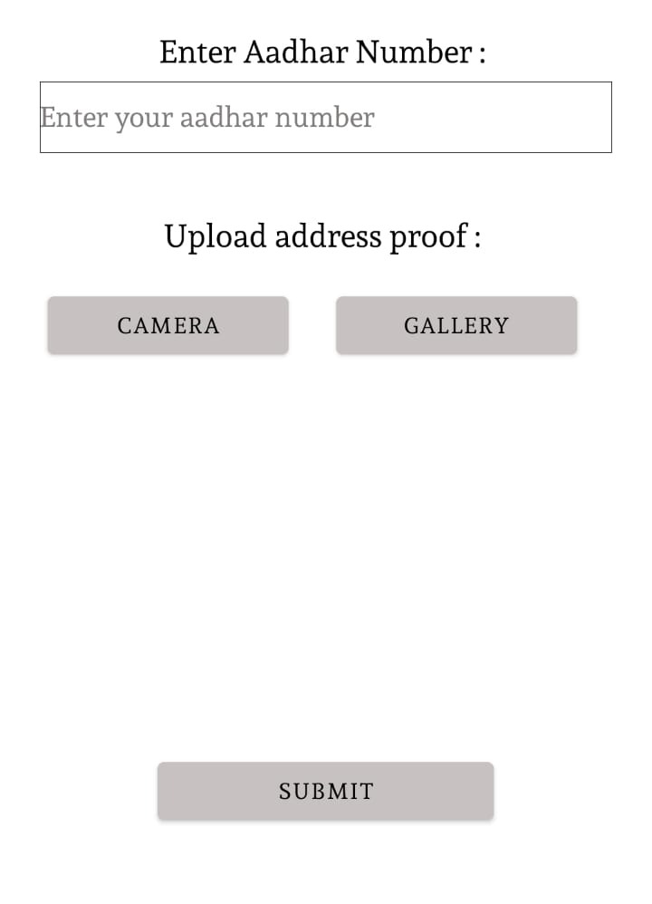
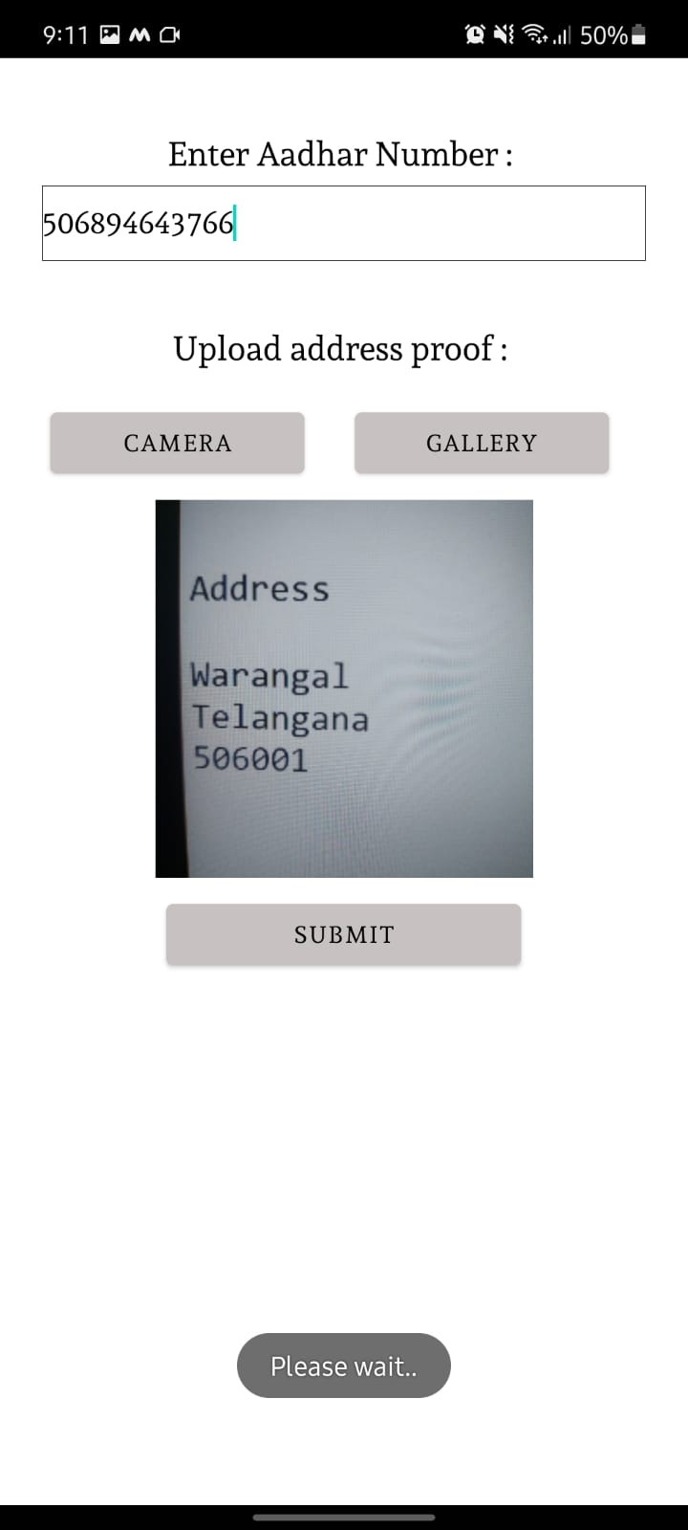
Procedure
1. Aadhaar number of the user should be given in the specified field and the supporting document like rental agreement/municipality bills is to be uploaded.

Slide 6
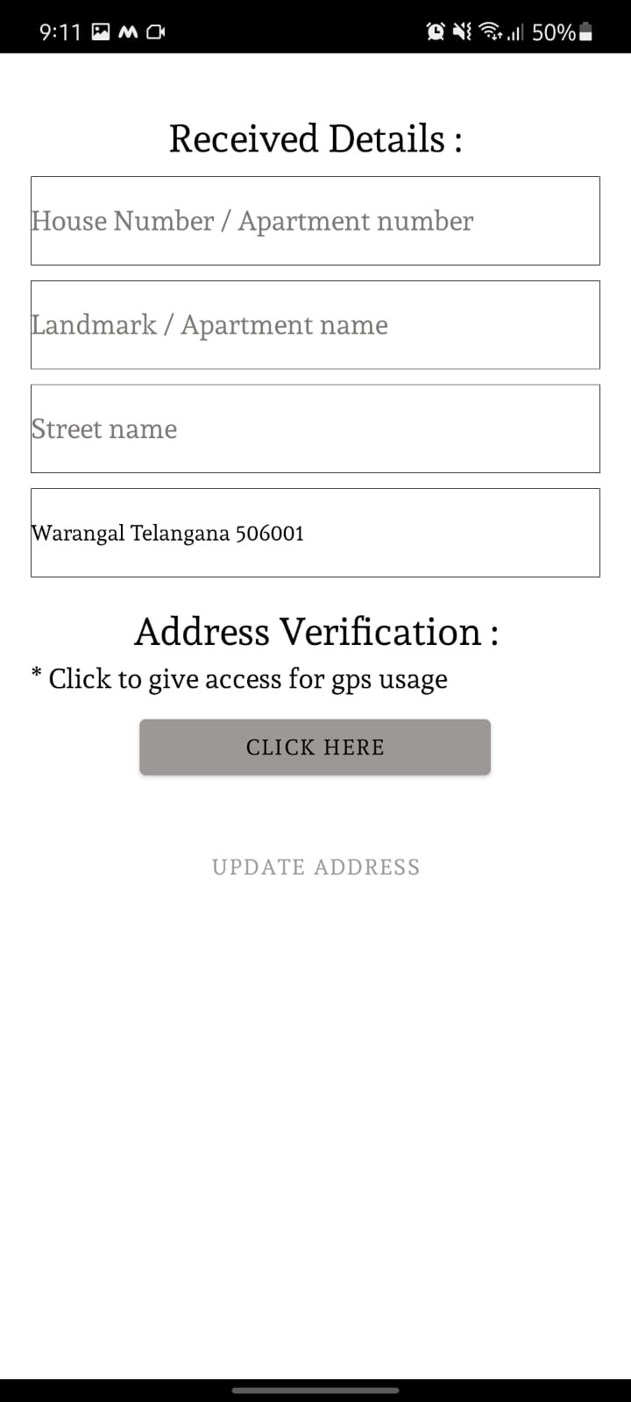
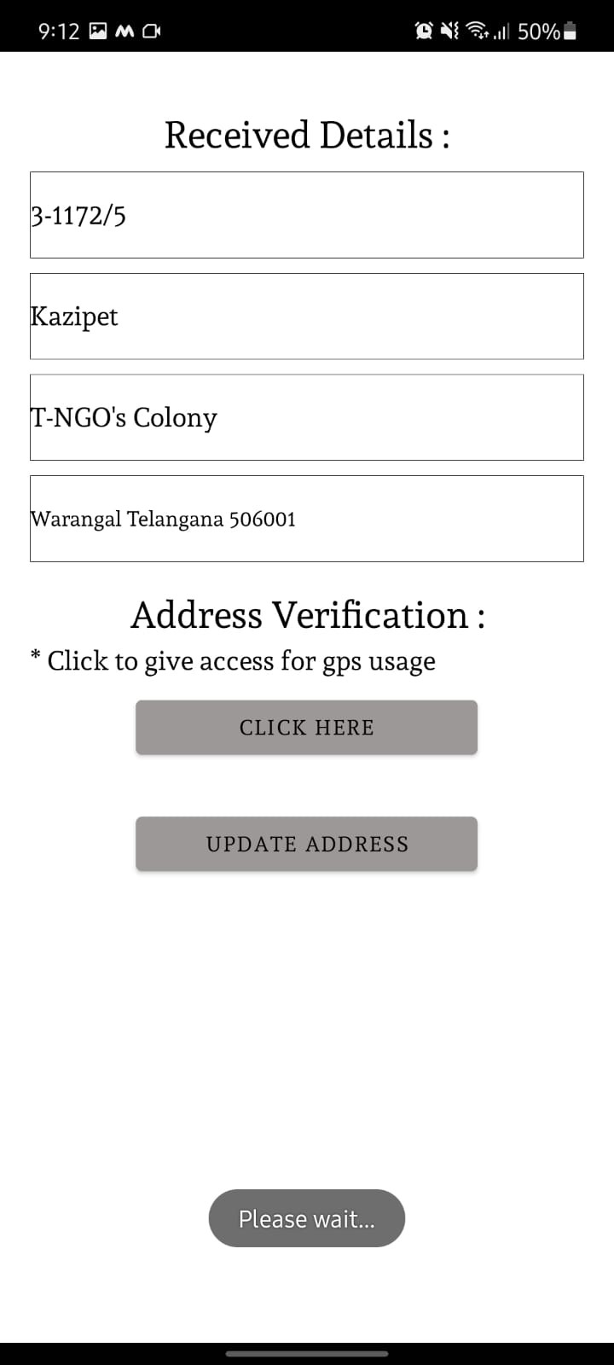
Procedure
2. Address is scanned from the uploaded document and the address is displayed to the user for any minor edits ( H. no /street name ). Operator should be physically present at user’s residence during the time of updation and should give access to GPS location so that the location can be validated with the given address.

Slide 7
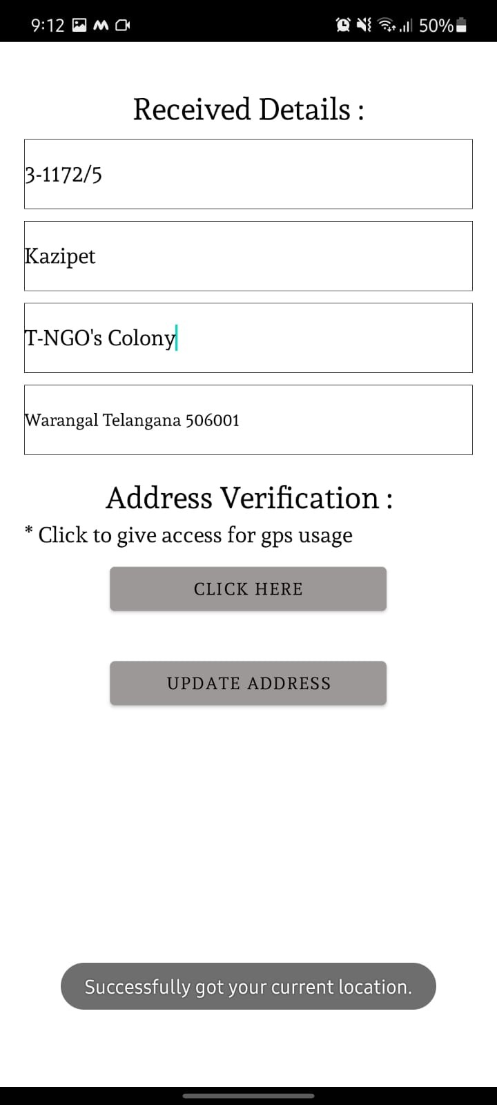
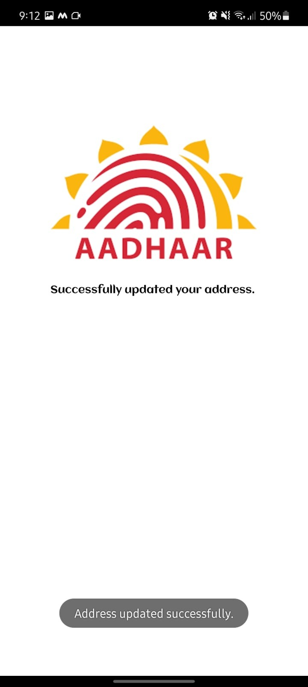
Procedure
Validation is done when the GPS location and the address provided in the supporting document matches.
If the validation is successful, the address updation will be done, else user should try again.

Slide 8
Advantages
Errors in address is one of the common mistake in Aadhaar cards.With this application we can solve this issue as we validate the address using GPS.
It takes less time for updation of address and reduces manual work.
It makes address updation easy as the process is totally online.

Slide 9
Conclusion
By, using this application user can update his address in Aadhaar without any intermediate steps.
With just a supporting document the user can update the Aadhaar address at his residence

Slide 10
Thank
You..

